Slide 1
EA/NGO & Stakeholders Drought Update
Rob Bakewell
East Anglia Area Drought Project Manager
22 September 2022

Slide 2
EA Information
Water Situation Reports can be found at:
https://www.gov.uk/government/collections/water-situation-reports-for-england
East Anglia Monthly reports can be found at:
https://www.gov.uk/government/publications/water-situation-local-area-reports
24-hour Incident Hotline: 0800 80 70 60

Slide 3
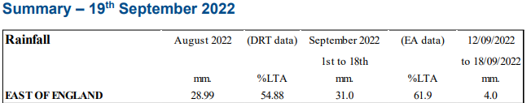
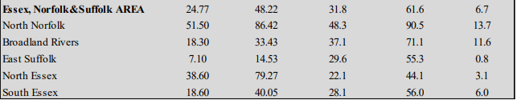
East Anglia (Essex, Norfolk & Suffolk)

Slide 4
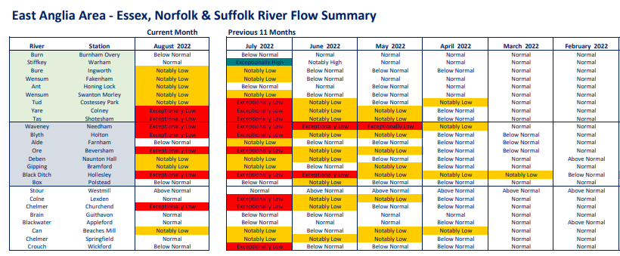
East Anglia (Essex, Norfolk & Suffolk)
River Flow Summary

Slide 5
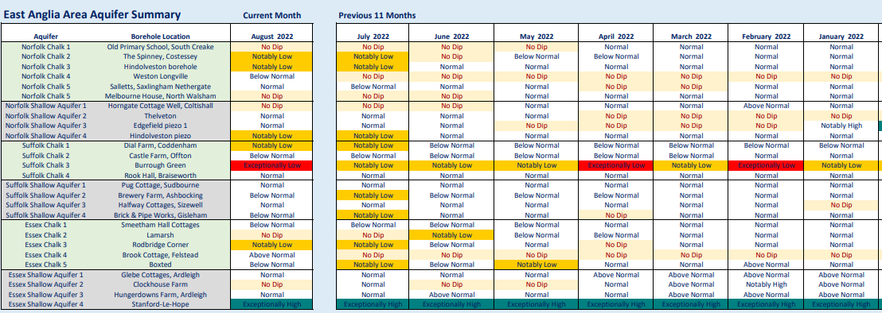
East Anglia (Essex, Norfolk & Suffolk)
Groundwater

Slide 6
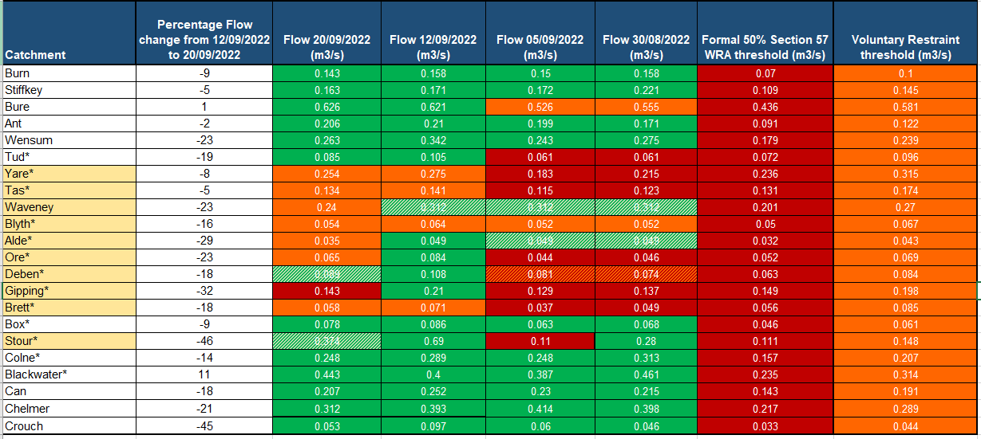
East Anglia (Essex, Norfolk & Suffolk)
Flow assessment

Slide 7
East Anglia (Essex, Norfolk & Suffolk)
Spray Irrigation Restrictions
EA Support Scheme Operation
  Waveney
  Deben
  Brett
Forward look – assessment work for risk of drought next year

Slide 8
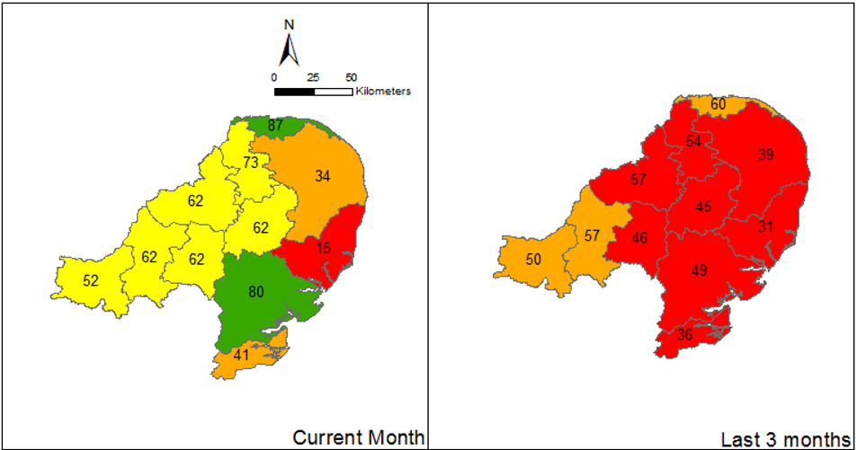
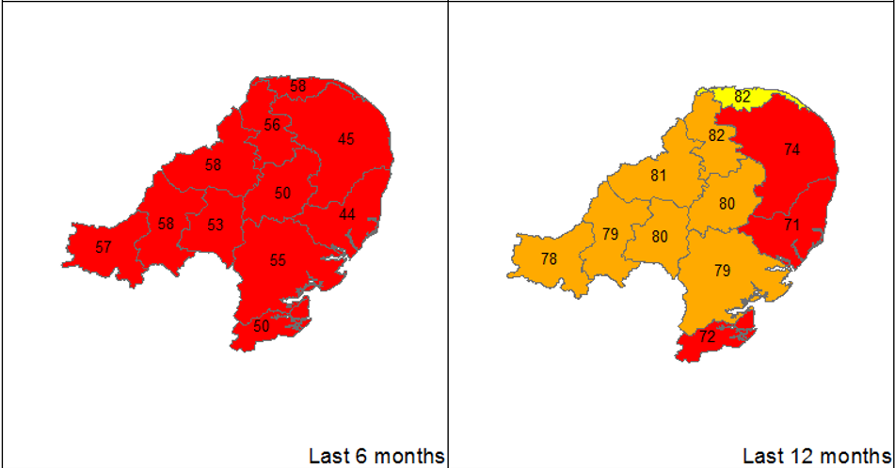
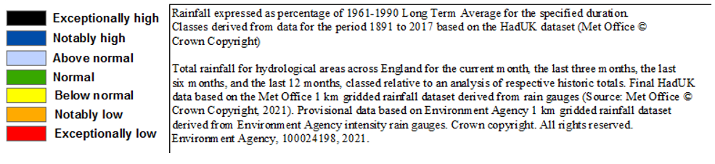
East Anglia (Cambs & Beds)
Rainfall up to the end of August

Slide 9
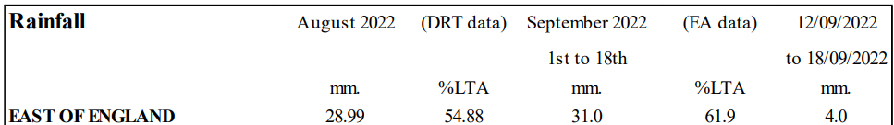
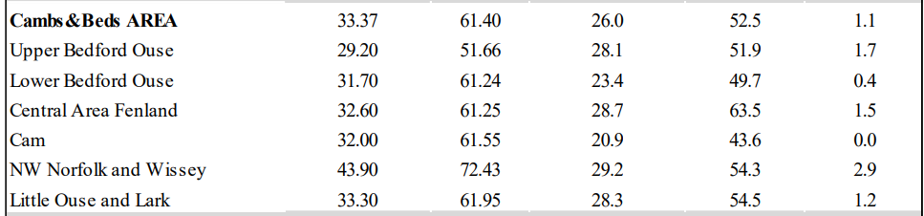
East Anglia (Cambs & Beds)
Rainfall in September

Slide 10
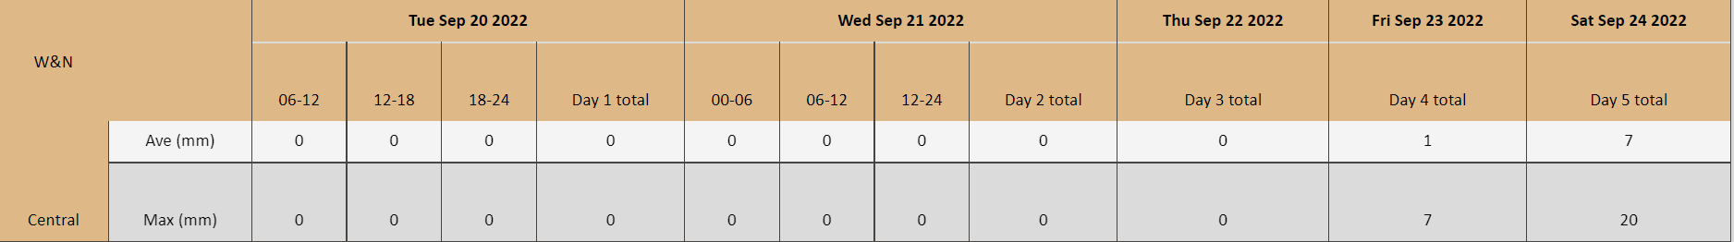

East Anglia (Cambs & Beds)
Rainfall forecast
This forecast rainfall would take us up to around 60-75 % of the long-term average rainfall for September (50 mm) by 24/09/2022.
England and Wales forecast

Slide 11
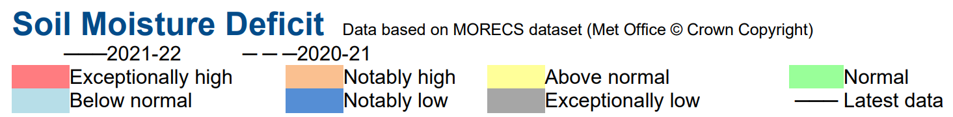
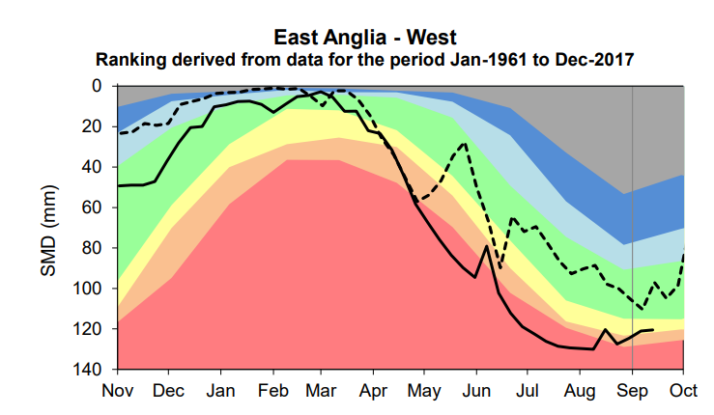
East Anglia (Cambs & Beds)

Slide 12
East Anglia (Cambs & Beds)
Groundwater levels

Slide 13
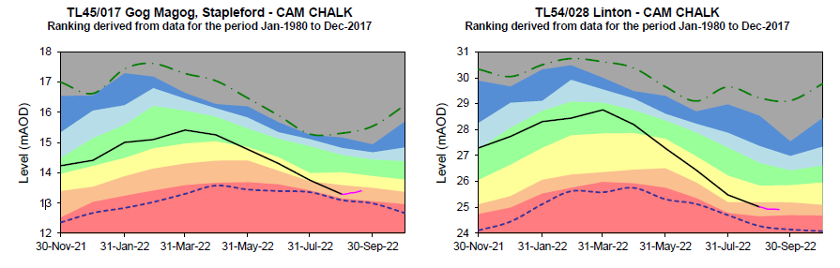
East Anglia (Cambs & Beds)
Weekly report 19/09/22 – Chalk GW sites

Slide 14
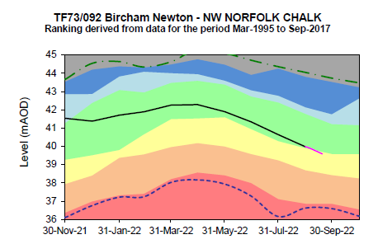
East Anglia (Cambs & Beds)
Weekly report 19/09/22 – NW Norfolk

Slide 15
East Anglia (Cambs & Beds)
Water Situation Report flow gauging stations

Slide 16
Ecological Drought Monitoring
Daniel Mills
Analysis & Reporting, Ecologist
22 September 2022

Slide 17
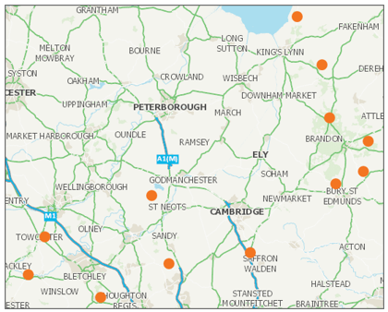
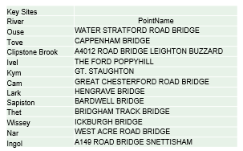
East Anglia (Cambs & Beds)
12 key ecological drought monitoring sites

Slide 18
East Anglia (Cambs & Beds)
Current Monitoring Programme - West
10 samples were collected from the Upper & Bedford Ouse and Cam & Ely Ouse catchments between 25th – 27th July 2022. Two samples were collected from the North West Norfolk catchment on 24th August 2022
Hydroecological Validation (HEV) Plots, are produced for each key site to assess the invertebrate community response to flow against two drought thresholds
LIFE scores are on or below the PDW guidance thresholds, which indicates that they are suffering some effects from low flows, at 6 sites (Water Stratford, Leighton Buzzard, Gt Staughton, Hengrave Bridge, Bardwell Bridge, West Acre)
River Cam and Ivel sites are starting to show early signs of deterioration, but have not yet dropped below the PDW guidance threshold
Riverfly Partnership monitoring flagged trigger level breaches at Hengrave on the River Lark and Great Abington on the River Granta, both of which were linked to flow impacts

Slide 19
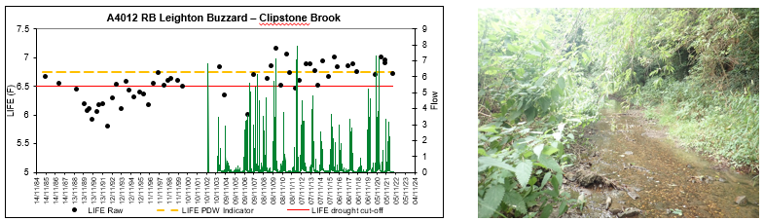
East Anglia (Cambs & Beds)
A4012 Road Bridge Leighton Buzzard – Clipstone Brook
Flow and levels were very low at the site when it was visited in July
The July 2022 sample shows LIFE score has fallen below the PDW threshold, in response to low flows
This site is rainfall dependent

Slide 20
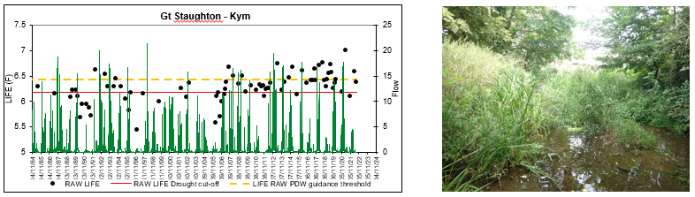
East Anglia (Cambs & Beds)
Gt. Staughton - Kym
Flows at this site appear to have been low since early 2022 and this may have stifled the initially strong recovery from 18/19 drought
Despite the site recovering slightly during the winter of 21/22 it has shown limited resilience to low flows since
Flows in the Kym are very dependent upon rainfall so can be highly variable and this site is shallow and can become covered in thick silt

Slide 21
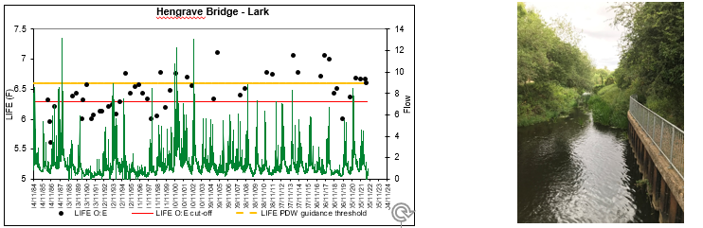
East Anglia (Cambs & Beds)
Hengrave Bridge - Lark
This site recovered slowly from 18/19 drought, returning just above the PDW threshold by Spring 2021
LIFE scores have remained consist until the most recent July 2022 sample which shows LIFE sitting on the PDW threshold
Signs of flow pressure were visible in July with a thick covering of silt over the majority of the substrate and a trace of probable sewage fungus under one stone

Slide 22
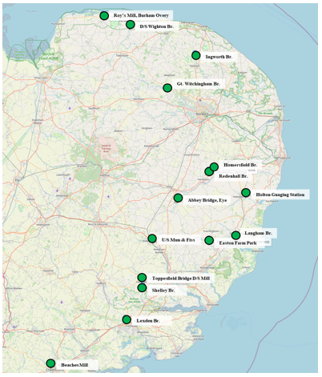
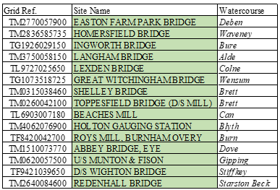
East Anglia (Essex, Norfolk & Suffolk)
15 key ecological drought monitoring sites

Slide 23
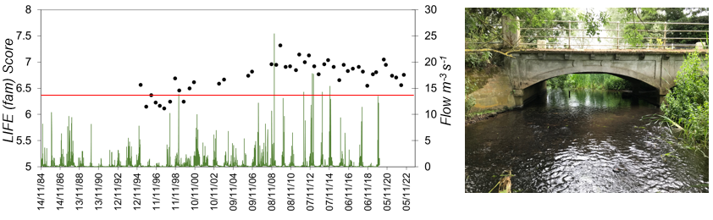
East Anglia (Essex, Norfolk & Suffolk)
Langham Bridge – R. Alde
Flow appeared within normal range, but water level seen as lower than usual when site was visited in July
The July sample shows LIFE score above the guidance threshold to indicate ecological deterioration.

Slide 24
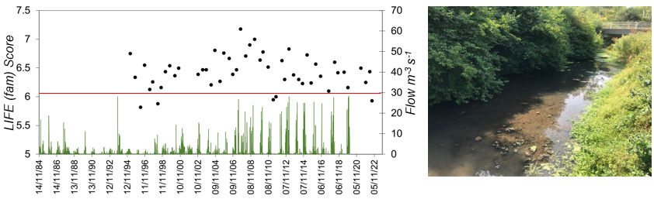
East Anglia (Essex, Norfolk & Suffolk)
Holton Gauging Station - R. Blyth
Flow and levels were lower than normal when site was visited in July, with significant build-up of silt across the channel.
The July 2022 sample shows LIFE score has fallen below the guidance threshold, in response to low flows

Slide 25
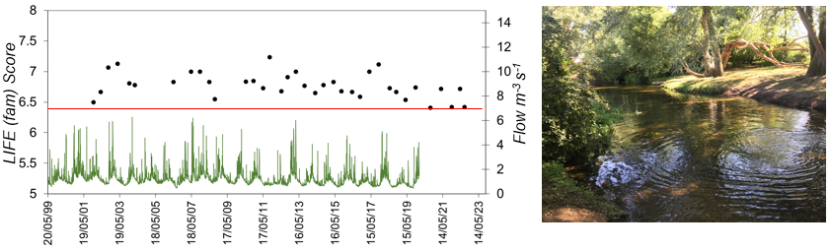
East Anglia (Essex, Norfolk & Suffolk)
Homersfield Bridge - R. Waveney
Flows and water level seen as lower than usual at the site when visited in July
The July 2022 sample shows LIFE score has fallen close to the guidance threshold, to similar levels as autumn samples in ‘19 & ’21.

Slide 26
East Anglia (Essex, Norfolk & Suffolk)
Summary - East Anglia ‘East’
12 samples were collected from key drought monitoring sites across various Norfolk, Suffolk & Essex catchments between 25th – 27th July ‘22. Also, 3 additional samples were collected from specific North Norfolk catchments on 17th August ‘22.
Currently, for those sites where sample analysis has been completed, results appear mixed. In two cases, LIFE scores remain within historically normal levels, above the respective guidance threshold at Langham Bridge (Alde) and Homersfield Bridge (Waveney). However, at Holton Gauging Station (Blyth), scores have dropped below this threshold, suggesting ecological deterioration here due to flow related pressures.
These provisional findings are limited. However, suggest different levels of ecological resilience to recent drought conditions across the ‘Eastern’ sites sampled.
We will keep colleagues and partners updated as we complete ongoing sample analysis and collect the next round of bi-monthly data from these sites (starting next week). Results from these efforts will clarify trends and identify ecological deterioration with greater confidence.

